Slide 1
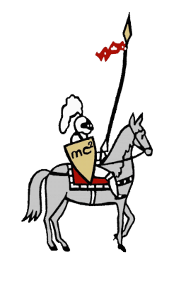

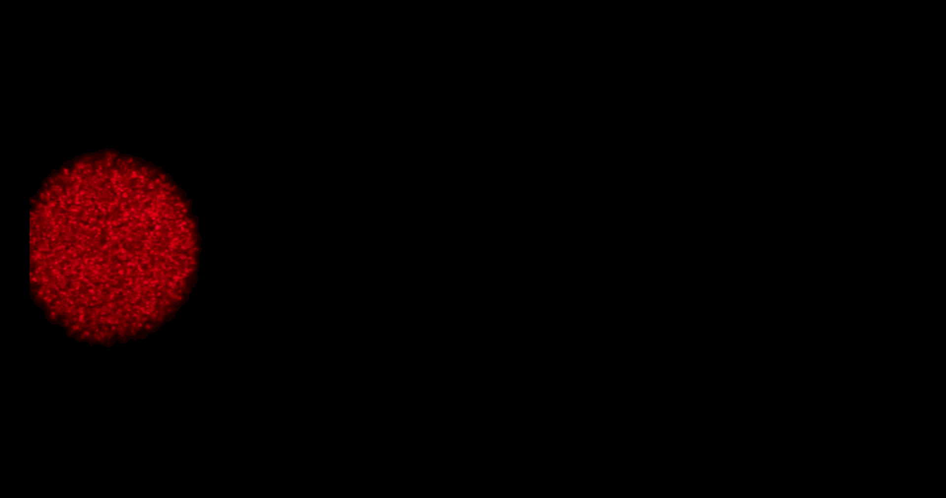
6. Drifting Speckles
Albert Ariel – Raffles Institution Team 2
Shine a laser beam onto a dark surface. A granular pattern can be seen inside the spot. When the pattern is observed by a camera or the eye, that is moving slowly, the pattern seems to drift relative to the surface. Explain the phenomenon and investigate how the drift depends on relevant parameters.
Video for viewing purposes
Notes:
Good morning judges, I am Albert Ariel from RI team 2 and I will be presenting on problem 6, drifting speckles
<Why uniform rough surface does not work>

Slide 2
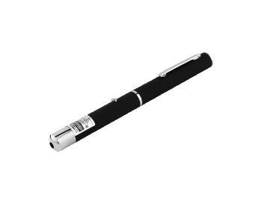

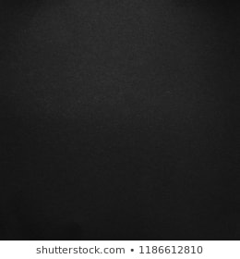

Problem Statement
Shine a laser beam onto a dark surface. A granular pattern can be seen inside the spot. When the pattern is observed by a camera or the eye, that is moving slowly, the pattern seems to drift relative to the surface. Explain the phenomenon and investigate how the drift depends on relevant parameters.
Notes:
When we [Click] shine a laser beam onto a dark surface, [Click] A granular pattern can be seen inside the spot. [Click] When the pattern is observed by a camera or the eye, that is moving slowly, [Click] the pattern seems to drift relative to the surface.
->video

Slide 3

Problem Statement
Shine a laser beam onto a dark surface. A granular pattern can be seen inside the spot. When the pattern is observed by a camera or the eye, that is moving slowly, the pattern seems to drift relative to the surface. Explain the phenomenon and investigate how the drift depends on relevant parameters.
Dependent Variables
Drift Velocity, $V_{d}$
Notes:
We will investigate drift velocity

Slide 4
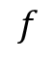
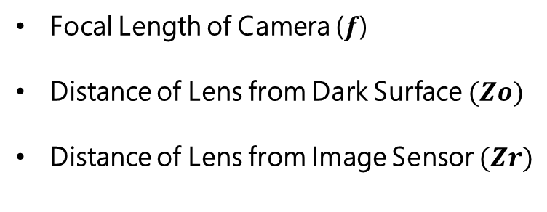
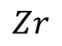
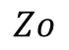
Problem Statement
Shine a laser beam onto a dark surface. A granular pattern can be seen inside the spot. When the pattern is observed by a camera or the eye, that is moving slowly, the pattern seems to drift relative to the surface. Explain the phenomenon and investigate how the drift depends on relevant parameters.
Independent Variables
$$f$$
Camera
Lens
Focal Length of Camera ($f$)
Distance of Lens from Dark Surface $(Zo)$
Distance of Lens from Image Sensor $(Zr)$
Laser spot
Image Sensor
$$Zo$$
$$Zr$$
Notes:
With respect to the [Click] focal length of camera, f, [Click] the distance of lens from dark surface, Zo, and [Click] the distance of lens from image sensor, Zr

Slide 5
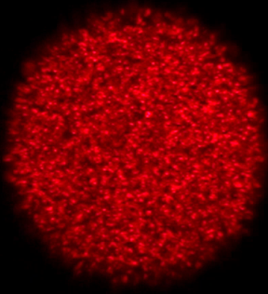
Definition
Speckle
Scattering Spot
Drift velocity refers to velocity of speckles relative to scattering spot
Notes:
We define a [Click] speckle to be a single granular pattern while [Click] scattering spot refers to the whole granular patter. [Click] Drift velocity refers to the velocity of speckles relative to scattering spot.

Slide 6
Overview
1
Introduction
Experimental Set-Up, Key Observations
Qualitative Explanation
Ray Tracing Analysis
2
3
Quantitative Model
Drift Simulation, Further Insights
4
Conclusion
Final Remarks
Notes:
Here is an overview of what we will be covering today

Slide 7
Introduction
Experimental Setup, Preliminary Observations
Notes:
First, we begin with an introduction

Slide 8
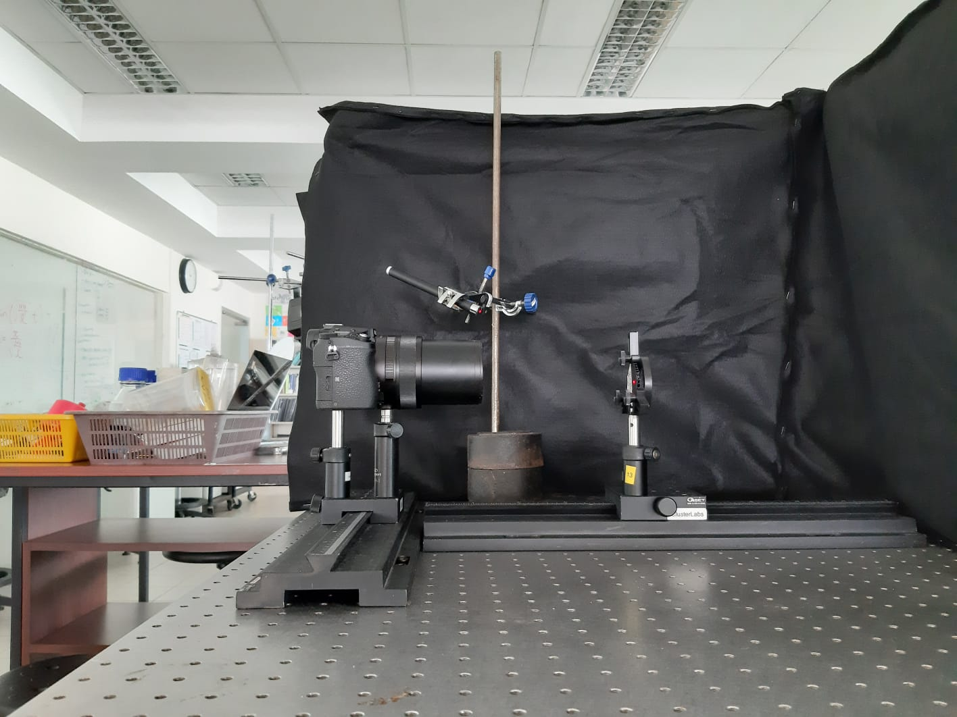
Experimental Setup
Side View
Laser
Camera
Dark Surface
Carriers
Optical Benches
Introduction
Qualitative
Quantitative
Conclusion
Notes:
Here is the side view of my setup. [Click] The laser is clamped to a retort stand. [Click] A camera is used to take pictures and a dark surface. [Click] Both the camera and the dark surface are mounted on carriers on top of optical benches.
-> animation sequence, dark surface close up

Slide 9
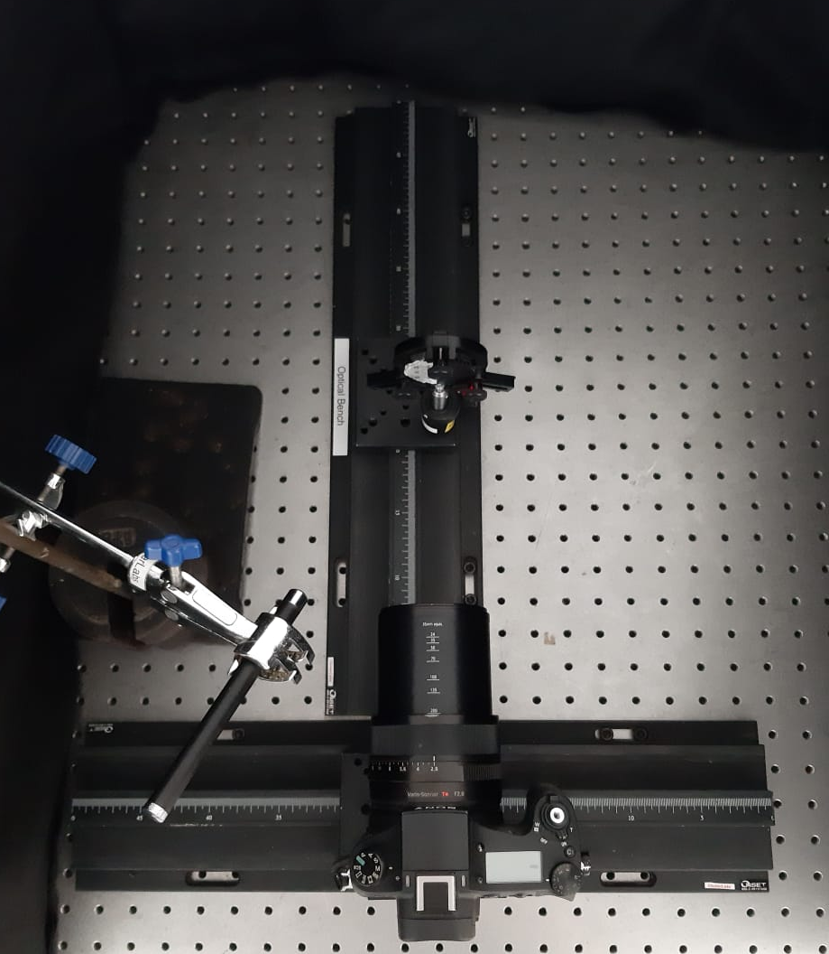
Experimental Setup
Top View
Optical Bench 2
Optical Bench 1
Introduction
Qualitative
Quantitative
Conclusion
Notes:
Here is the top view of my experimental setup. [Click] Using optical bench one the camera is translated laterally [Click] . To ensure uniform velocity, I took multiple pictures at equal intervals of distance and stitched them together. [Click] Using optical bench two, the distance of the camera from the dark surface is varied.

Slide 10
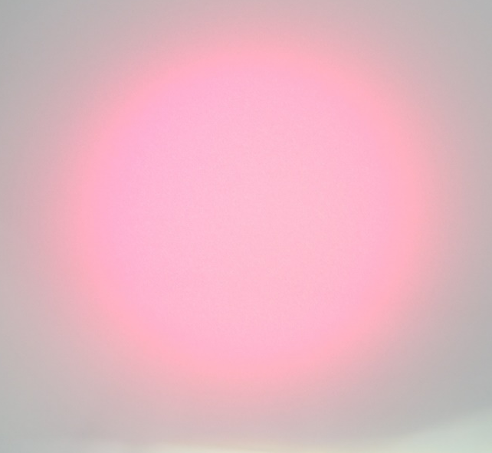
Preliminary Observations – Rough Surface
Dark Surface
At Optical Level
Water as Reflector
Introduction
Qualitative
Quantitative
Conclusion
Notes:
First, we observe that the granular pattern is only observed when [Click] the surface is rough at optical level. If light is reflected off a smooth surface instead, such as a still water surface, [Click] no such pattern is observed.

Slide 11
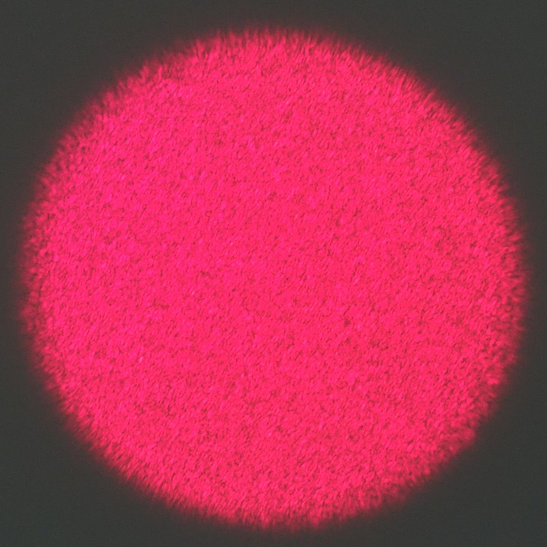
Preliminary Observations – Dark Surface
Dark Surface
Bright Surface
Introduction
Qualitative
Quantitative
Conclusion
Notes:
Secondly, dark surface is used to minimize oversaturation which makes it hard to see the granular pattern

Slide 12
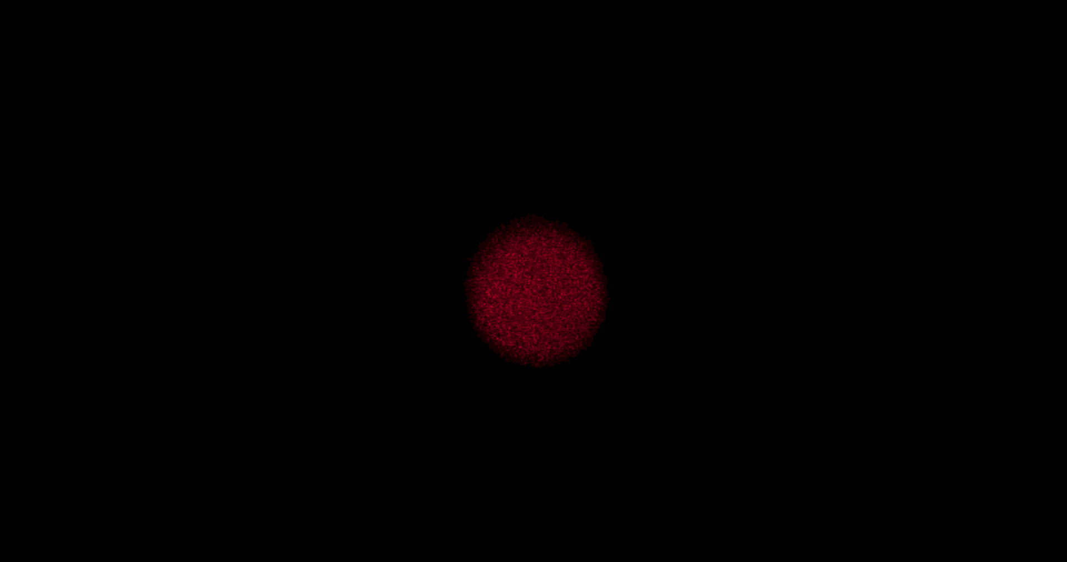

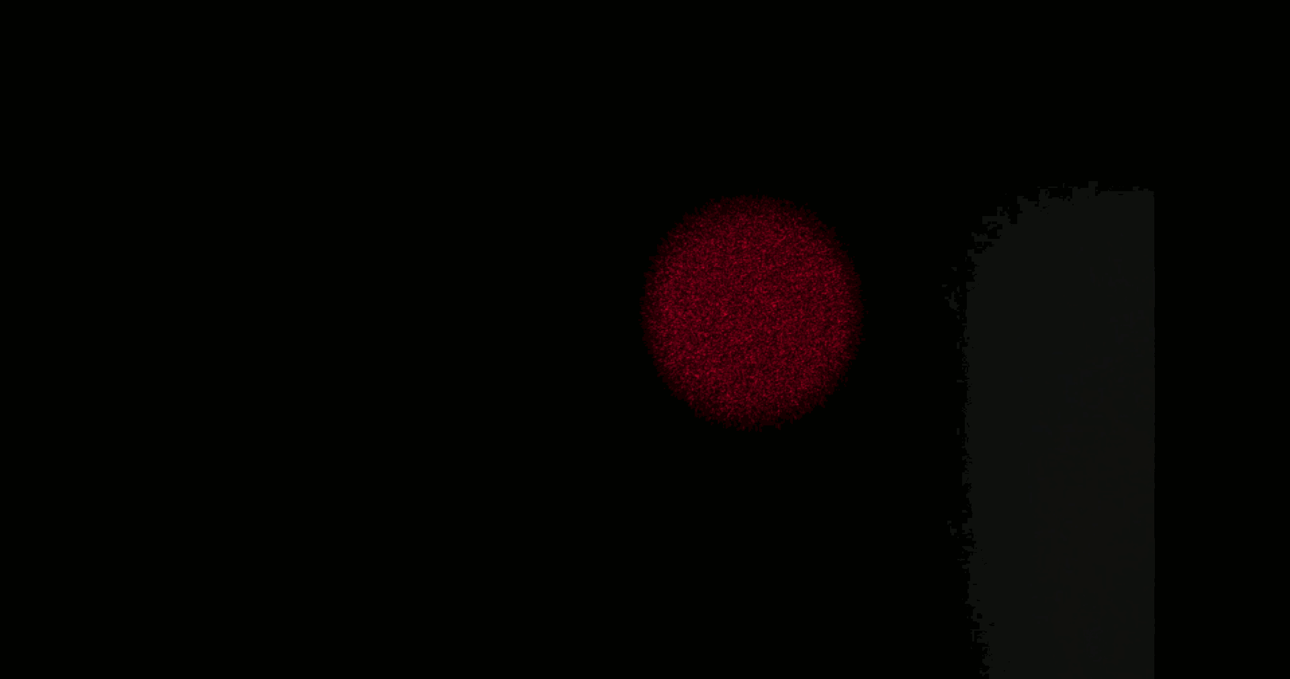
Preliminary Observations – Granular Pattern vs Drift
Introduction
Qualitative
Quantitative
Conclusion
Notes:
Thirdly, we observe that the same drift velocity can be observed while having completely different granular pattern

Slide 13
Preliminary Observations -Drift
Nearsighted Myopic View
Farsighted/ Hyperopic View
Image Sensor
Image Sensor
Introduction
Qualitative
Quantitative
Conclusion
Notes:
Finally, we can observe drifts in two cases of drift, nearsighted and farsighted.

Slide 14
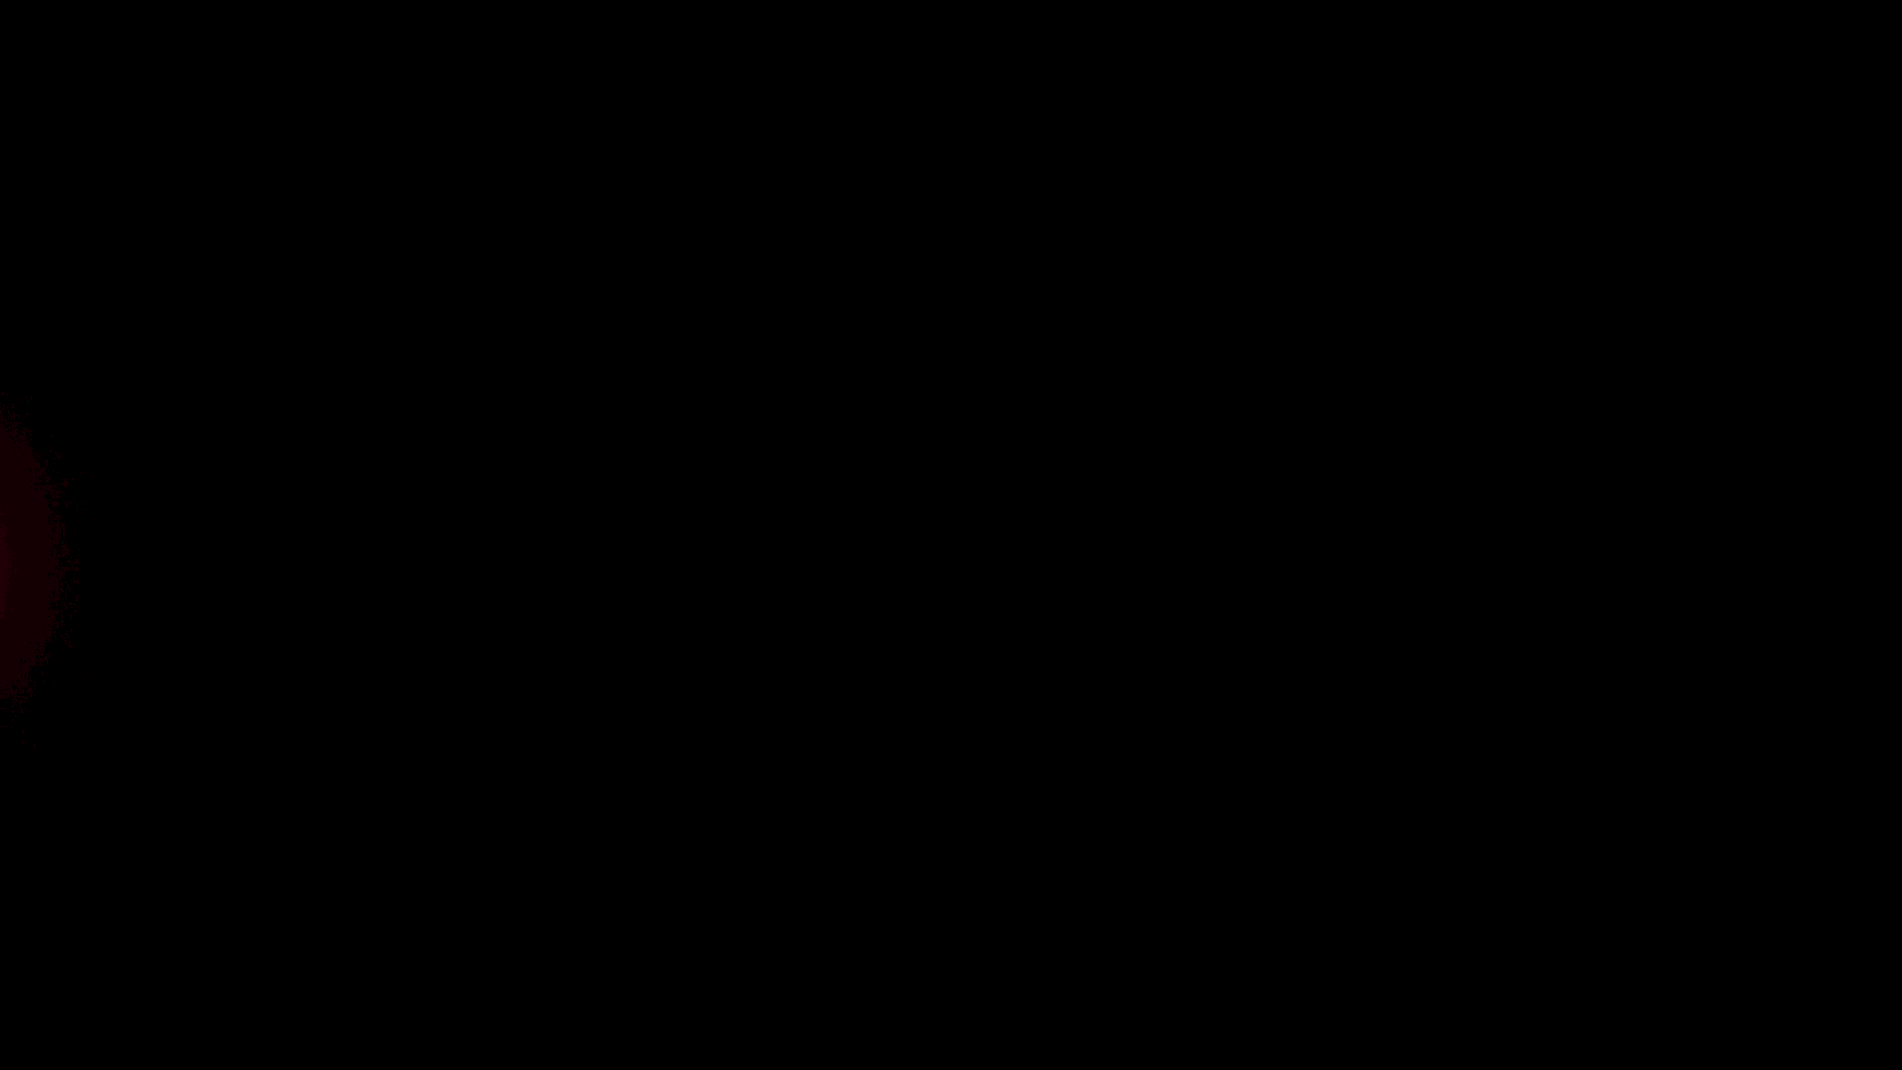
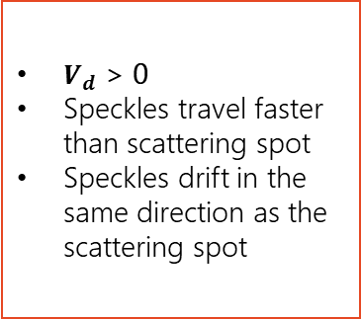
Preliminary Observation – Drift Nearsighted Case
Nearsighted/ Myopic View
$V_{d}$ > 0
Speckles travel faster than scattering spot
Speckles drift in the same direction as the scattering spot
Video for viewing purposes
Introduction
Qualitative
Quantitative
Conclusion
Notes:
Under the nearsighted case, the drift velocity is positive. This means that the speckles travel faster than the scattering spot and seem to drift in the same direction as the scattering spot

Slide 15
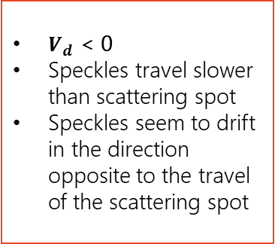
Preliminary Observations – Drift Farsighted Case
Farsighted/ Hyperopic View
$V_{d}$ < 0
Speckles travel slower than scattering spot
Speckles seem to drift in the direction opposite to the travel of the scattering spot
Video for viewing purposes
Introduction
Qualitative
Quantitative
Conclusion
Notes:
Under the farsighted case, the drift velocity is negative. This means that the speckles travel slower than the scattering spot and seem to drift in the direction opposite to the travel of the scattering spot.

Slide 16
Qualitative Explanation
Notes:
Now, we explain our observations. {2 min 30 s}

Slide 17
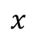
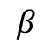
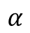
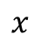
Speckle Drift – Nearsighted View
Laser Spot
$$x$$
Focal Points
Lens
$$x$$
Image Position
Image Sensor
$$α$$
Position of Scattering Spot
Position of Speckle
$$β$$
Initial Position
Introduction
Qualitative
Quantitative
Conclusion
Notes:
Let there be a lens of such focal points [Click] and a laser spot [Click] at the shown initial position. [Click] Let the position of the scattering spot be indicated by a green dot [Click] and the position of the speckle be indicated by a blue dot. [Click] At the start, both are at the same position. [Click] When the lens moves by x to the right,, from the lens’ frame of reference, [Click] the laser spot has moved by x to the left. [Click] Let’s consider two light rays to find where the image is formed. [Click] And let’s consider nearsighted view where the image sensor is behind the image position. [Click] The scattering spot has moved by alpha [Click] and the speckle has moved by beta. In the nearsighted view, the speckle traveled more distance, moved faster and drifted in the same direction as scattering spot.

Slide 18
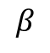
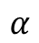
Speckle Drift – Farsighted View
Laser Spot
$$x$$
Focal Points
Image Position
$$β$$
Image Sensor
$$α$$
$$α$$
Position of Scattering Spot
Position of Speckle
$$β$$
Initial Position
Introduction
Qualitative
Quantitative
Conclusion
Notes:
Now, let’s consider farsighted view where [Click] the image sensor is in front of the image position. [Click] Here, the scattering spot has travelled a distance alpha, which is further than[Click] the distance beta travelled by the speckle. Thus, under the farsighted view, the speckle travelled less distance, moved slower and drifted in the opposite direction as scattering spot

Slide 19
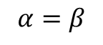
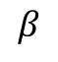
Speckle Drift – Perfect View
Laser Spot
$$x$$
Focal Points
Image Sensor
Image Position
$$β$$
$$α=β$$
$$α$$
Position of Scattering Spot
Position of Speckle
Initial Position
Introduction
Qualitative
Quantitative
Conclusion
Notes:
Now, let’s consider perfect view, where [Click] the image sensor is in on the image position. [Click] Here, the speckle and the scattering spot have travelled the same distance, and hence no drift is observed. However, to predict the motion more accurately I will use a quantitative theory based on full wave calculation theory
<Why infinity?>

Slide 20
Quantitative Account
Notes:
Now, let’s move on to my quantitative account

Slide 21
Theory Map
Full Wave Calculation
Simulation of Formation of Speckle Field
A
Characterization
Optical System
B
Experimental Verification
Speckle Drift, Granular Pattern
C
Introduction
Qualitative
Quantitative
Conclusion
Notes:
I will start with simulation of speckle field formation using full wave calculation theory

Slide 22
Full Wave Calculation
Laser
Camera
Dark Surface
Image Sensor
Millions of Individual Light Rays
Introduction
Qualitative
Quantitative
Conclusion
Notes:
We simulate the laser beam as [Click] a bundle of millions of individual light rays of known wavelength.

Slide 23
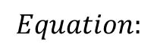
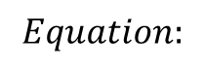
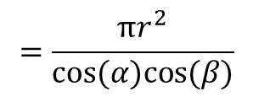
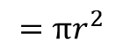
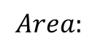
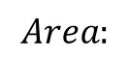
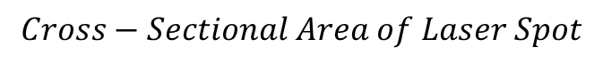
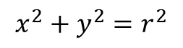
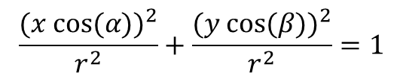
Full Wave Calculation
Laser
Camera
Dark Surface
Image Sensor
$$Cross−Sectional Area of Laser Beam$$
$$Cross−Sectional Area of Laser Spot$$
$$Equation:$$
$$Equation:$$
$$x^{2}+y^{2}=r^{2}$$
$$\frac{{(x cos⁡(α))}^{2}}{r^{2}}+\frac{{(y cos⁡(β))}^{2}}{r^{2}}=1$$
$$Area:$$
$$Area:$$
$$=\frac{πr^{2}}{cos⁡(α)cos⁡(β)}$$
$$=πr^{2}$$
Introduction
Qualitative
Quantitative
Conclusion
Notes:
Although the cross-sectional area of the laser beam is a circle, the laser spot will be an ellipse when the laser is shone at an angle [Click] and the laser spot area is expressed as follows

Slide 24
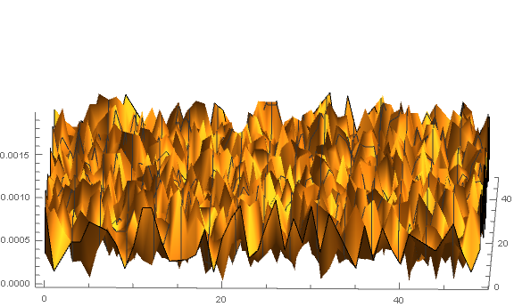
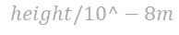
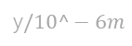
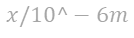
Full Wave Calculation
Laser
Camera
Dark Surface
Image Sensor
$$height/10^−8m$$
y$/10^−6m$
Simulated Rough Surface
$$x/10^−6m$$
Introduction
Qualitative
Quantitative
Conclusion
Notes:
From here, we can simulate the rough surface with a 3d surface array of random height of known area. Here’s a sample of such surface

Slide 25
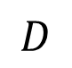
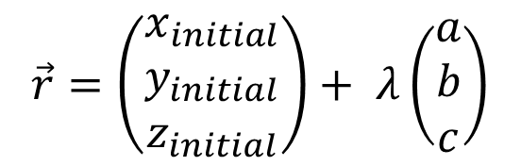
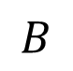
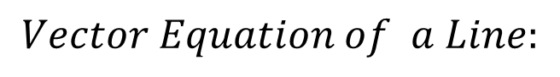
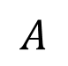
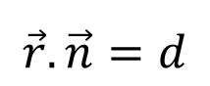
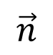
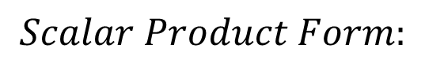
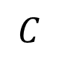
Full Wave Calculation
Laser
Camera
Dark Surface
Image Sensor
$$A$$
$$B$$
$$Scalar Product Form:$$
$$\vec{r}.\vec{n}=d$$
$$Vector Equation of a Line:$$
$$D$$
$$C$$
$$\vec{r}=\left(\begin{matrix}x_{initial} \\ y_{initial} \\ z_{initial}\end{matrix}\right)+ λ\left(\begin{matrix}a \\ b \\ c\end{matrix}\right)$$
$$\vec{n}$$
Introduction
Qualitative
Quantitative
Conclusion
Notes:
For each array coordinate, we can express the plane at that coordinate [Click] as a scalar product while we can express each light ray as a [Click] vector equation of a line

Slide 26
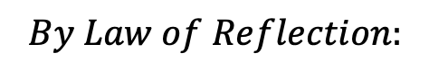
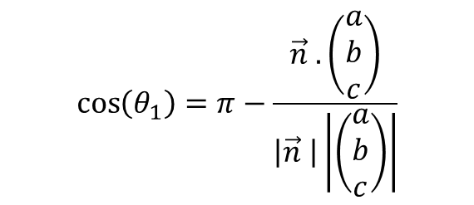



Full Wave Calculation
Laser
Camera
Dark Surface
Image Sensor
$$A$$
$$B$$
$$\cos\left(θ_{1}\right)=π−\frac{\vec{n} .\left(\begin{matrix}a \\ b \\ c\end{matrix}\right)}{\left|\vec{n} \right|\left|\left(\begin{matrix}a \\ b \\ c\end{matrix}\right)\right|}$$
$$θ_{1}$$
$$D$$
$$C$$
$$By Law of Reflection:$$
$$\vec{n}$$
$$θ_{2}=θ_{1}$$
$$θ_{2}=θ_{1}$$
Introduction
Qualitative
Quantitative
Conclusion
Notes:
From this, we can solve the angle at which the light ray intersects the plane and the angle at which it is reflected

Slide 27
Full Wave Calculation
Laser
Camera
Dark Surface
Image Sensor
Single Lens
Introduction
Qualitative
Quantitative
Conclusion
Notes:
Afterwards, we need to find how the light is refracted by the camera lens which we simplified as a single effective lens

Slide 28











Full Wave Calculation
Laser
Camera
Dark Surface
Image Sensor
$$a$$
$$\vec{r}=\left(\begin{matrix}x_{initial} \\ y_{initial} \\ z_{initial}\end{matrix}\right)+ λ\left(\begin{matrix}a \\ b \\ c\end{matrix}\right)$$
$$Lens as overlap of two spheres:$$
$$θ_{1}$$
$$θ_{2}$$
$$R^{2}=\left\{\begin{aligned}{(x−R+a )}^{2}+y^{2}+z^{2} for x≤0 \\ {(x+R−a )}^{2}+y^{2}+z^{2} for x>0\end{aligned}\right.$$
$$\vec{n}$$
$$R=Lens Radius$$
$$\frac{x−x_{initial}}{a}=\frac{y−y_{initial}}{b}=\frac{z−z_{initial}}{c}$$
$$Snell^{′}s Law$$
$${n_{air}sin⁡(θ}_{1})=n_{lens}sin⁡(θ_{1})$$
Introduction
Qualitative
Quantitative
Conclusion
Notes:
We then describe the lens as an overlap of two spheres and by [Click] expressing the light ray vector in Cartesian form, we can find where exactly the light ray enters the lens. [Click] After finding the normal vector at that point, we can also find the incident angle. [Click] By Snell’s law, we can find the angle at which this light ray is refracted, theta 2.

Slide 29


Full Wave Calculation
Laser
Camera
Dark Surface
$$(α,β)$$
$$(x,y)$$
Image Sensor
Image Sensor
Introduction
Qualitative
Quantitative
Conclusion
Notes:
Then, we find exactly where each light ray lands on the image sensor, which we model as an array [Click] where light rays which are incident on the same array coordinate will interfere [Click]. This models pixilation algorithm
<What is pixilation algorithm?>

Slide 30

Full Wave Calculation
Laser
Camera
Dark Surface
$$(α,β)$$
$$(x,y)$$
Image Sensor
$$E= \sum_{n=0}^{N}{E_{n_{0}}e^{i(\frac{2π}{λ}x_{n})}}$$
Introduction
Qualitative
Quantitative
Conclusion
Notes:
We then express the sum of light rays at that coordinate as the following. Where xn refers to the length of path travelled by the light ray.

Slide 31

Full Wave Calculation
Laser
Camera
Dark Surface
$$(α,β)$$
$$(x,y)$$
Image Sensor
$${{|E}_{r_{0}}|}^{2}=\sum_{n=0}^{N}{{E_{n_{0}}}^{2}}+2\sum_{n^{′}>n}^{N}{\sum_{n=0}^{N−1}{E_{{n^{′}}_{0}}}}E_{n_{0}}cos⁡(\frac{2π}{λ}x_{n^{′}} −(\frac{2π}{λ}x_{n}))$$
$$I∝{|E_{r_{0}}|}^{2}$$
Introduction
Qualitative
Quantitative
Conclusion
Notes:
By algebraic formula, the resultant wave is given by this [Click] And hence the intensity at each pixel is [Click] as expressed.

Slide 32




Full Wave Calculation
$$Predict speckle drift$$
$$Speckle Contrast,$$
$$SC= \frac{σ_{I}}{I_{avg}}$$
$$Granular Pattern Density, GPD= \frac{N_{speckle}}{N_{pixel}}$$
Simulated Image
Introduction
Qualitative
Quantitative
Conclusion
Notes:
From here, we can obtain an intensity map which is plotted as follows. By moving the lens in the simulation, we will be able to simulate [Click] speckle drift. Other than that, this map also allows us to calculate speckle contrast and granular pattern density which can be used to characterize the granular pattern. [Click] SC is defined as standard deviation of intensity over average intensity while [Click] granular pattern density is the number of speckles per pixel

Slide 33
Theory Map
Full Wave Calculation
Simulation of Formation of Speckle Field
A
Characterization
Optical System
B
Experimental Verification
Speckle Drift, Granular Pattern
C
Introduction
Qualitative
Quantitative
Conclusion
Notes:
Now, let’s move on to the characterization of our optical system [7 min]

Slide 34



Characterization – Optical System
$$Distance of Lens$$
$$from Image Sensor (Z_{r})$$
$$Distance of Lens$$
$$from Dark Surface(Z_{o})$$
Image Sensor
Laser Spot on Dark Surface
Effective Lens
Introduction
Qualitative
Quantitative
Conclusion
Notes:
From the exif files of the photos, we can simplify the [Click] camera lens system into a single lens of known focal length and lens radius. [Click] However, we do not know the position of this effective lens.
<exif files?>

Slide 35




Characterization – Optical System
$$Z_{o}+Z_{r}$$
$$Z_{o}+Z_{r}$$
Introduction
Qualitative
Quantitative
Conclusion
Notes:
To find this we need to find the distance between the image sensor and the dark surface. [Click] the position of the image sensor is indicated by this symbol on the camera

Slide 36


Characterization – Optical System
$$Lens Equation: \frac{1}{f}=\frac{1}{Z_{o}}+\frac{1}{Z_{i}}$$
Focus Ring
Introduction
Qualitative
Quantitative
Conclusion
Notes:
We focus the image by rotating the focus ring to cause [Click] the image sensor to be at the image position [Click]. The lens equation can be solved to determine the position of the focal point. [Click] Then by moving the dark surface closer or farther from camera, the nearsighted or farsighted case can be obtained, respectively.
-> simplified diagram with components

Slide 37
Theory Map
Full Wave Calculation
Simulation of Formation of Speckle Field
A
Characterization
Optical System
B
Experimental Verification
Speckle Drift, Granular Pattern
C
Introduction
Qualitative
Quantitative
Conclusion
Notes:
Now, let’s move on to experimental verification [7 min 40s]

Slide 38






Speckle Drift - Distance of Lens from Image Sensor (Zr)
Parameters:
Focal Length: 7.33 cm
$\dot{x}$: -1 cm/s
$Z_{0}$: 21.4 cm
$$Theory$$
$$Experimental$$
Introduction
Qualitative
Quantitative
Conclusion
Notes:
As we vary the distance of the lens from the image sensor, Zr, we observed that drift velocity increases

Slide 39







Speckle Drift - Distance of Lens from Image Sensor (Zr)
$$Zo$$
$$f$$
$$Zr$$
$$Zr$$
Parameters:
Focal Length: 7.33 cm
$\dot{x}$: -1 cm/s
$Z_{0}$: 21.4 cm
$$Theory$$
Position of Speckle
Position of Scattering Spot
$$Experimental$$
Introduction
Qualitative
Quantitative
Conclusion
Notes:
This is because initially, we observe a farsighted case where drift velocity is negative, where the speckle travels slower than scattering spot. [Click] As Zr increases, we will be able to get a perfect eye view where drift velocity is zero and [Click] finally nearsighted view where drift velocity is positive.

Slide 40




Speckle Drift - Distance of Lens from Dark Surface (Zo)
Parameters:
Focal Length: 7.33 cm
$\dot{x}$: -1 cm/s
$Z_{r}$: 9.22 cm
$$Theory$$
$$Experimental$$
Introduction
Qualitative
Quantitative
Conclusion
Notes:
We also observe that drift velocity increases as the distance of lens from dark surface, Zo, increases.

Slide 41








Speckle Drift - Distance of Lens from Dark Surface (Zo)
$Z$o
$$Zo$$
Parameters:
Focal Length: 7.33 cm
$\dot{x}$: -1 cm/s
$Z_{r}$: 9.22 cm
$$Zo$$
$$f$$
$$f$$
$$Zr$$
$$Zr$$
$$Theory$$
Position of Speckle
Position of Scattering Spot
$$Experimental$$
Introduction
Qualitative
Quantitative
Conclusion
Notes:
This is because, initially farsighted case where drift velocity is negative is observed. [Click]However as Zo increases, we will be able to get a perfect eye view

Slide 42


Speckle Drift - Distance of Lens from Dark Surface (Zo)
$Z$o
$$Zo$$
$$Zo$$
Parameters:
Focal Length: 7.33 cm
$\dot{x}$: -1 cm/s
$Z_{r}$: 9.22 cm
$$f$$
$$f$$
$$Zr$$
$$Zr$$
$$Theory$$
Position of Speckle
Position of Scattering Spot
$$Experimental$$
Introduction
Qualitative
Quantitative
Conclusion
Notes:
And finally nearsighted view where drift velocity is positive

Slide 43




Speckle Drift – Focal Length (f)
Parameters:
$\dot{x}$: -1 cm/s
$Z_{o}$: 21.4 cm
$Z_{r}$: 9.06cm
$$Theory$$
$$Experimental$$
Introduction
Qualitative
Quantitative
Conclusion
Notes:
For focal length, we observe that increasing focal length causes the drift velocity to decrease.

Slide 44








Speckle Drift – Focal Length (f)
$$f$$
$$Zo$$
$$Zo$$
$$f$$
$$f$$
$$Zr$$
Parameters:
$\dot{x}$: -1 cm/s
$Z_{o}$: 21.4 cm
$Z_{r}$: 9.06cm
$$Zr$$
$$Theory$$
Position of Speckle
Position of Scattering Spot
$$Experimental$$
Introduction
Qualitative
Quantitative
Conclusion
Notes:
As can be seen here we first observe a nearsighted case where drift velocity is positive. [Click] However, as the focal length increases, we will observe perfect view case

Slide 45



Speckle Drift – Focal Length (f)
$$Zo$$
$$Zo$$
$$f$$
$$f$$
$$f$$
$$Zr$$
Parameters:
$\dot{x}$: -1 cm/s
$Z_{o}$: 21.4 cm
$Z_{r}$: 9.06cm
$$Zr$$
$$Theory$$
Position of Speckle
Position of Scattering Spot
$$Experimental$$
Introduction
Qualitative
Quantitative
Conclusion
Notes:
And finally, [Click] farsighted case where drift velocity is negative

Slide 46











Speckle Drift – Motion Path
$$Theory$$
Nearsighted:
Focal Length: 7.33 cm
$\dot{x}$: -1 cm/s
$Z_{r}$: 8.95 cm
$${Exp (Z}_{o}=15.5 cm)$$
$${Exp (Z}_{o}=19 cm)$$
$${Exp (Z}_{o}=26 cm)$$
Farsighted:
Focal Length: 7.33 cm
$\dot{x}$: -1 cm/s
$Z_{r}$: 13.06 cm
$$Theory$$
$${Exp (Z}_{o}=40 cm)$$
$${Exp (Z}_{o}=21.5 cm)$$
Introduction
Qualitative
Quantitative
Conclusion
Notes:
Using this theory, we are also able to predict the motion path for both nearsighted and farsighted case

Slide 47





Granular Pattern - Wavelength
$$Pixel$$
 | Granular Pattern Density: Wavelength: 680 nm Theory: 0.00136 patterns/ pixel Experimental: 0.0014 patterns/ pixel
 | Granular Pattern Density: Wavelength: 540nm Theory: 0.00243 patterns/ pixel Experimental: 0.0025 patterns/ pixel
Experimental
Theory
$$Pixel$$
$$Pixel$$
Experimental
Theory
Introduction
Qualitative
$$Pixel$$
Quantitative
Conclusion
Notes:
On top of that, this theory also can predict the characteristics of granular pattern. For example, red laser, which has longer wavelength than green laser has higher granular pattern density.

Slide 48





Granular Pattern – Surface Profile
Speckle Contrast Sand Paper Grit Size = 220 Theory: 0.59 Experimental: 0.603639 | Speckle Contrast Sand Grit Size = 320 Theory: 0.64 Experimental: 0.64789 | Speckle Contrast Grit Size = 800 Theory: 0.86 Experimental: 0.83124
Experimental
Experimental
Experimental
$$Pixel$$
$$Pixel$$
$$Pixel$$
Theory
Theory
Theory
$$Pixel$$
$$Pixel$$
$$Pixel$$
Introduction
Qualitative
Quantitative
Conclusion
Notes:
We also observe a change in speckle contrast as we change the surface profile.

Slide 49


Summary
Drift Velocity
Pattern Density
Distance of Lens from Dark Surface (Zo) | Drift Velocity
Distance of Lens from Image Sensor (Zr) | Drift Velocity
Focal Length (f) | Drift Velocity
Wavelength | Granular Pattern Density
Speckle Contrast
Surface Profile | Speckle Contrast
$$Δ$$
$$Δ$$
Introduction
Qualitative
Quantitative
Conclusion
Notes:
In short, increasing z nought and z r increases the drift velocity. Increasing the focal length decreases the drift velocity. Increasing the wavelength decreases the granular pattern density and changing the surface profile changes the speckle contrast.
Drift Velocity
<Whats the intensity scaling here?>

Slide 50
Conclusion
Notes:
In conclusion

Slide 51



Shine a laser beam onto a dark surface. A granular pattern can be seen inside the spot. When the pattern is observed by a camera or the eye, that is moving slowly, the pattern seems to drift relative to the surface. Explain the phenomenon and investigate how the drift depends on relevant parameters.
Qualitative
Rough Surface
Dark vs Bright Surface
Cause of Drift
Notes:
we discussed qualitatively why a rough and dark surface is necessary to observe the drift.

Slide 52



Shine a laser beam onto a dark surface. A granular pattern can be seen inside the spot. When the pattern is observed by a camera or the eye, that is moving slowly, the pattern seems to drift relative to the surface. Explain the phenomenon and investigate how the drift depends on relevant parameters.
Quantitative
Full Wave Calculation:
Speckle Drift
Granular Pattern
$$Theory$$
$${Exp (Z}_{o}=40 cm)$$
$${Exp (Z}_{o}=21.5 cm)$$
Notes:
And we were able to predict the drift of the speckles and characteristics of the granular pattern quantitatively using full wave calculation

Slide 53
Thank You
Albert Ariel – Raffles Institution Team 2
Shine a laser beam onto a dark surface. A granular pattern can be seen inside the spot. When the pattern is observed by a camera or the eye, that is moving slowly, the pattern seems to drift relative to the surface. Explain the phenomenon and investigate how the drift depends on relevant parameters.
Video for viewing purposes
Notes:
Thank you

Slide 54


Full Wave Calculation
Laser
Camera
$$Zo$$
$$Zr$$
Dark Surface
$$(α,β)$$
$$(x,y)$$
Image Sensor
$$α=x+ Zosin\left(θ_{1}\right)+Dsin\left(θ_{2}\right)+Zrsin\left(θ_{3}\right)$$
$$β=y+ Zosin\left(θ_{4}\right)+Dsin\left(θ_{5}\right)+Zrsin\left(θ_{6}\right)$$
Introduction
Qualitative
Quantitative
Conclusion
Notes:
For each light ray, we need to find the correlation function between [Click] their x,y coordinates on the dark suface and [Click] the alpha beta coordinates on the image sensor. [Click] Given that Zo and Zr are as follow, alpha and beta can be found [Click] by the following equation. [Click] since they are similar, we shall only look at alpha in details. [Click] Now, let’s consider this light ray.

Slide 55





Full Wave Calculation
Laser
Camera
Dark Surface
$$(α,β)$$
$$(x,y)$$
$$height/10^−4m$$
Image Sensor
$$θ_{1}$$
Simulated Rough Surface (Side View)
Not drawn to scale
$$x/10^−6m$$
$$α=x+ Zosin\left(θ_{1}\right)+Dsin\left(θ_{2}\right)+Zrsin\left(θ_{3}\right)$$
Introduction
Qualitative
Quantitative
Conclusion
Notes:
Firstly, [Click] theta1 refers to the angle at which light is reflected off the surface. This can be found using the law of reflection. [Click]

Slide 56

Full Wave Calculation
Laser
Camera
Dark Surface
$$(α,β)$$
$$(x,y)$$
Image Sensor
$$θ_{2}$$
Not drawn to scale
$$α=x+ Zosin\left(θ_{1}\right)+Dsin\left(θ_{2}\right)+Zrsin\left(θ_{3}\right)$$
Introduction
Qualitative
Quantitative
Conclusion
Notes:
Secondly, [Click] theta2 refers to the angle at which light is refracted when entering the lens. This can be found using snell’s law [Click]

Slide 57

Full Wave Calculation
Laser
Camera
Dark Surface
$$(α,β)$$
$$(x,y)$$
Image Sensor
$$θ_{3}$$
Not drawn to scale
$$α=x+ Zosin\left(θ_{1}\right)+Dsin\left(θ_{2}\right)+Zrsin\left(θ_{3}\right)$$
Introduction
Qualitative
Quantitative
Conclusion
Notes:
Lastly, [Click] theta 3 is the angle at which light ray is refracted when exiting the lens. It can be found by Snell's law [Click]

Slide 58
Full Wave Calculation
Laser
Camera
$$Zo$$
$$Zr$$
Dark Surface
$$(α,β)$$
$$(x,y)$$
Image Sensor
$$α=x+ Zosin\left(θ_{1}\right)+Dsin\left(θ_{2}\right)+Zrsin\left(θ_{3}\right)$$
$$β=y+ Zosin\left(θ_{4}\right)+Dsin\left(θ_{5}\right)+Zrsin\left(θ_{6}\right)$$
Introduction
Qualitative
Quantitative
Conclusion
Notes:
From this alpha and beta coordinates, we are able to know where exactly each light ray fall on the image sensor. Then, we need to find the resultant wave of light ray which falls onto the same part of the image sensor to calculate the amplitude at that point. [Click]

Slide 59
Full Wave Calculation
Laser
Camera
Dark Surface
$$(α,β)$$
$$(x,y)$$
Image Sensor
$$E=E_{n0}e^{i(\frac{2π}{λ}x_{n}+α_{n})}$$
$$x_{n}=\sqrt{{\left(Zosin\left({θ_{1}}_{n}\right)\right)}^{2}+{\left(Zocos\left({θ_{1}}_{n}\right)\right)}^{2}+{\left(Zosin\left({θ_{4}}_{n}\right)\right)}^{2}}+n\sqrt{{\left(Dsin\left({θ_{2}}_{n}\right)\right)}^{2}+{\left(Dcos\left({θ_{2}}_{n}\right)\right)}^{2}+{\left(Dsin\left({θ_{5}}_{n}\right)\right)}^{2}}+\sqrt{{\left(Zrsin\left({θ_{3}}_{n}\right)\right)}^{2}+{\left(Zrcos\left({θ_{3}}_{n}\right)\right)}^{2}+{\left(Zrsin\left({θ_{6}}_{n}\right)\right)}^{2}}$$
Introduction
Qualitative
Quantitative
Conclusion
Notes:
[Click] In order to do that, we describe each light ray as the following. Where xn refers to the length of path travelled by the light ray [Click] Hence, the resultant wave is the following. [Click] since the light from the laser is coherent, we can erase the alphan term

Slide 60



Slide 61


Characterization – Surface, Laser
Average Surface Height/ $μm$ | Maximum Surface Height/ $μm$ | Minimum Surface Height/ $μm$ | Particle Diameter/ $μm$
6.273 | 74.05 | 45.35 | 28.16
E.G. 800 Grit Size Sandpaper
Introduction
Qualitative
Quantitative
Conclusion
Notes:
As our dark surface, we use sandpapers of different grit sizes of known surface profile such as average height, minimum and maximum peak as well as average particle diameter. [Click] From this profile we are able to generate a surface model which can be plotted as follow

Slide 62

Characterization – Surface, Laser
Laser
Diffraction Grating Method
Introduction
Qualitative
Quantitative
Conclusion
Notes:
We also use laser of known wavelength and we use diffraction grating method to verify the wavelength

Slide 63






Speckle Drift – $\dot{X}$
Nearsighted:
Focal Length: 7.33 cm
$Z_{0}$: 21.5 cm
$Z_{r}$: 9.06 cm
$$Theory$$
$$Experimental$$
Introduction
Qualitative
Quantitative
Conclusion
Notes:
We also observe that v

Slide 64
Lens Radius, Lens Height
Lens Curvature: 62.1 cm
Lens Diameter: 5.11 cm
Introduction
Qualitative
Quantitative
Conclusion
Notes:
Since the lens diameter is small, less than 10%, compared to the curvature of the lens, the lens can be considered as thin lens where aberration is insignificant

Slide 65




Focus vs Not in focus (1mm away)

Slide 66





Ray Tracing Analysis – Nearsighted View
$$x$$
$$Zo$$
$$x_{scattering spot}=−\left(\frac{Zr}{Zo}\right)x$$
$$Zr$$
Image Sensor
Image Position
$$x_{scattering spot}$$
Position of Speckle
Position of Scattering Spot
Initial Position
Introduction
Qualitative
Quantitative
Conclusion
Notes:
Given that [Click] the distance of lens from light source on the dark surface is Zo and [Click] the distance of lens from the image sensor is Zr, [Click] by similar triangles, [Click] the movement of the scattering spot is given by [Click] the following

Slide 67


Ray Tracing Analysis – Nearsighted View
$$x$$
$$Zo$$
$x_{speckle}=−\left(\frac{Zr}{f}−1\right)$x
$$f$$
$$Zr$$
Image Sensor
Image Position
Position of Speckle
Position of Scattering Spot
Initial Position
Introduction
Qualitative
Quantitative
Conclusion
Notes:
Given that the focal length of the lens is f, [Click] by comparing the red and green triangles, the movement of speckle will be given by [Click] the following

Slide 68



Ray Tracing Analysis – Nearsighted View
$$x$$
$$Relative to scattering spot:$$
$$Zo$$
$$x_{speckle}=−\left(Zr\left(\frac{1}{f} −\frac{1}{Zo}\right) − 1\right)x$$
$$f$$
$$Zr$$
Image Sensor
Image Position
$$v_{d}=−\left(Zr\left(\frac{1}{f} −\frac{1}{Zo}\right) − 1\right)\dot{x}$$
Position of Speckle
Position of Scattering Spot
Initial Position
Introduction
Qualitative
Quantitative
Conclusion
Notes:
Hence, the movement of the speckle relative to the scattering spot is as expressed and by differentiating with respect to time, [Click] the drift velocity is the following where xdot refers to the velocity of light source from the camera’s frame of reference. Unfortunately this theory does not account for the characteristics of the granular pattern

Slide 69



Mathematical Representation
Complex Representation of Random Phasor Sum
$$A=\frac{1}{\sqrt{N}}\sum_{n=1}^{N}{a_{n}e^{jθ_{n}} }$$
Real Component of A
$$R=Re\left[A\right\}=\frac{1}{\sqrt{N}}\sum_{n=1}^{N}{a_{n}cos∅_{n} }$$
Imaginary Component of A
$$I=Im\left[A\right\}=\frac{1}{\sqrt{N}}\sum_{n=1}^{N}{a_{n}sin∅_{n} }$$
Notes:
So, the complex representation of random phasor sum will be this. Hence the real component is this. And the imaginary component is this

Slide 70

Assumptions
1. The amplitude${ a}_{n}$ and phases${ ∅}_{n}$ are statistically independent of ${ a}_{m}$ and phases${ ∅}_{m}$ provided n is not equal to m.
2. For n, ${ a}_{n}$ and ${ ∅}_{n}$ are statistically independent of each other.
3. The phases ${ ∅}_{m}$, are uniformly distributed on the interval (-π,π).
Notes:
Under the following assumption, the first assumption which means the knowledge of the amplitude and/ or phase of one of the component phasors conveys no knowledge about the amplitude and/ or phase of another component phasor.
And the second assumption which means knowledge of the phase of a component phasor conveys no knowledge of the value of the amplitude of that same phasor, and vice versa
And the third assumption which means all values of phase are equally likely

Slide 71



Density Distribution of $R$and $I$
By Central Limit Theorem, the statistics of the sum of N independent random variables is asymptotically Gaussian as N approaches infinity.
$$ρ_{R,I}(R,I)=\frac{1}{2πσ^{2}}exp\left\{−\frac{R^{2}+I^{2}}{2σ^{2}}\right\}$$
$$σ^{2}=σ_{R}^{2 }=σ_{I}^{2}=\frac{1}{N}\sum_{n=1}^{N}{\frac{{E[a_{n}}^{2}]}{2} }$$
Notes:
The Density distribution of real and imaginary parts will be [Click]. Where the variance is this

Slide 72



Density Distribution of $R$and $I$
$$I$$
$$R$$
Notes:
Graphically, it will look like this

Slide 73







Density Distribution of $A$and $θ$
Expressing in terms of Amplitude, $A$, and Phase, $θ$
$$ρ_{A,θ}(A,θ)=\frac{A}{2πσ^{2}}exp\left\{−\frac{A^{2}}{2σ^{2}}\right\}$$
Integrating with respect to $A$
$$ρ_{A}(A)=\frac{A}{σ^{2}}exp\left\{−\frac{A^{2}}{2σ^{2}}\right\}$$
Integrating with respect to $θ$
$$ρ_{θ}(θ)=\frac{1}{2π}$$
Notes:
Hence, the density distribution of amplitude and phase will be this. Integrating with respect to A and theta respectively, we will get the density distribution of A and theta

Slide 74







Density Distribution of $I$
Deriving $ρ_{I}(I)$ from $ρ_{A}(A)$
$ρ_{I}\left(I\right)=\frac{1}{2\sqrt{I}}ρ_{A}\left(\sqrt{I}\right)$= $\frac{1}{{2σ}^{2}}exp\left\{−\frac{i}{2σ^{2}}\right\}$
Contrast, $C$
$${C=\frac{σ_{i}}{I_{ave}}}_{}$$
Signal-to-noise ratio, $S/N$
$${\frac{S}{N}=1/C=\frac{I_{ave}}{{σ_{i}}_{}}}_{}$$
Notes:
From A, we can derive the distribution of intensity which is this and contrast as well as signal to noise ratio which are important to determine whether the speckles are fully or partially developed and polarized. As they may effect the properties of the speckles.

Slide 75



5
Imaging system can be defined by its point spread function $k\left(x,y;α,β\right)$
$k\left(x,y;α,β\right)=\frac{1}{λ^{2}z^{2}}e^{\frac{jπ}{λz}(α^{2}+β^{2})}\iint_{−∞}^{∞}{P(ξ,η)e^{−\frac{j2π}{λz}[ξ\left(α+x\right)+η\left(β+y\right)]}dξdη}$
Image Field A$\left(x,y\right)$
$$\text{A}\left(x,y\right)=\iint_{−∞}^{∞}{k\left(x,y;α,β\right)a(α,β)dαdβ}$$
Notes:
The imaging system can be defined by its point spread function k. P refers to the pupil function of the imaging system. The image field capital A is related to the scattered field a

Slide 76






5
Cross-correlation function $μ_{A}\left(Δx,Δy\right)$
$$μ_{A}\left(Δx,Δy\right)=M_{h}(Δq_{z})ψ(Δx,Δy)$$
$$ψ\left(Δx,Δy\right)=\frac{\iint_{−∞}^{∞}{P\left(ξ,η\right)e^{−\frac{j2π}{λz}\left[ξ\left(α+x\right)+η\left(β+y\right)\right]}dξdη}}{\iint_{−∞}^{∞}{a{bs(P\left(ξ,η\right))}^{2}dξdη}}$$
$$ψ\left(Δx,Δy\right)$$
$$Δq_{z}$$
$Δq_{z}=abs(\frac{2π}{λ_{1}}\left[cosθ_{01}+cosθ_{i1}\right]−\frac{2π}{λ_{2}}\left[cosθ_{02}+cosθ_{i2}\right]$)
Notes:
The cross-correlation function is given by .While PSI and $Δq_{z}$ are as follow. Mh is the characteristic surface-height fluctuation and is a function of $Δq_{z}$ refers to the effective roughness of the surface. The effect of change in wavelength, theta 1 and theta 2 is accounted by change in Mh.

Slide 77

Appendix A
Linear dimension of the n x n array to be used
Number of samples per speckles
Generate an n/k x n/k array of random phasors
Pad the phasor array with zeros. The scattering spot is square of size n/k x n/k
Find the FFT of the padded padded array. This is the speckle field in the observation plane
Find the intensity of the observed speckle field

Slide 78

Appendix B
Define the circle function
Define the rectangle function
Linear dimension of the n x n array to be used
Number of samples per speckles
Radius of the lens pupil function in the pixels
Defining object intensity distribution in the absence of speckle
Generate an n x n array of random phasors
The object amplitude distribution is multiplied by the array of random phasors
Plot the intensity distribution across the scattering surface
Define circular pupil function of the lens
Calculate the field transmitted by the lens pupil
Calculate the image field
Calculate the image intensity
Plot the intensity of the speckled image
Show the original object intensity distribution and the speckled image intensity distribution

Slide 79




Laser Spot
$$x$$
Focal Points
Lens
$$x$$
Image Position
Image Sensor
$$α$$
Position of Scattering Spot
Position of Speckle
$$β$$
Initial Position
Notes:
so1) we look at a point (A) on the focal plane of the lens, and find the ray that takes the least time to travel from the laser spot to this point.2) we consider a small bundle of parallel rays centered on the reference ray, when they pass through the lens they will all focus on the point.2a) the bundle will constructively interfere because their path length does not vary much from the reference ray. for rays farther away, the phase will vary much more rapidly as a function of position, so on average the phasor contibutions from the region outside the bundle is ~02b) the parallel bundle converges on the point A under 2 conditions ...i) the width of the bundle is much smaller than the radius of curvature of the thin lens...ii) the angle from the optical axis is <<1... if i) is violated, the bundle will still converge to a point, just that the point of convergence will be closer to the lensthen, you can perform the same geom optics on the movement of the laser spot and the speckle, assuming that the source of the speckle rays moves with the laser spot
if they question a lot on the explanation, you can say that the qualitative analysis simplifies a few aspects of the problem, so it cant be 100% correct
and that there is no complete way to describe the phenomenon without doiing the full numerical analysis

Slide 80


Slide 81


Slide 82

18. Dank Memes
Albert Ariel – Raffles Institution Team 2
Notes:
Good morning judges, I am Albert Ariel from RI Team 2 and today I will be presenting on problem number 6, drifting speckles

Slide 83

3D NAVIER STOKES SIMULATION
H2 SHM
w/ wrong force resolution
Notes:
Secondly, we were able to generate a phase plot to predict whether same or opposite drift will be observed using ray tracing analysis and predict the motion path of speckles using full wave calculation.

Slide 84

CAT B
SYPT 2020
Singapore Young Parameters Tournament
Singapore Young Physicist’ Tournament
Notes:
Secondly, we were able to generate a phase plot to predict whether same or opposite drift will be observed using ray tracing analysis and predict the motion path of speckles using full wave calculation.

Slide 85

People who put in efforts trying to understand complex physics equations in year 3
SYPT Cat B judges
People who don’t understand physics/ can’t physics but just vary parameters
SYPT Cat B judges
Notes:
Secondly, we were able to generate a phase plot to predict whether same or opposite drift will be observed using ray tracing analysis and predict the motion path of speckles using full wave calculation.

Slide 86

No one:
Absolutely no one:
Not a single soul:
Rgs:
DiD YoU VarY tHiS PaRAmEtEr?
Notes:
Secondly, we were able to generate a phase plot to predict whether same or opposite drift will be observed using ray tracing analysis and predict the motion path of speckles using full wave calculation.

Slide 87


Slide 88


Slide 89


Slide 90


Slide 91


Slide 92


